Slide 1
Automatic colorization of gray-scale images using deep attention models.
-Vrishabh Lakhani

Slide 2
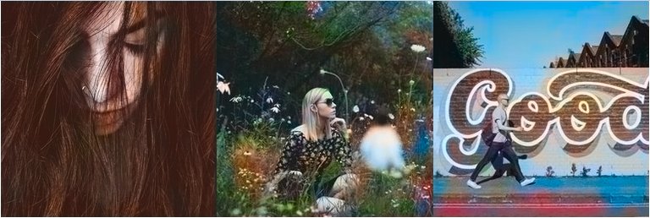
What is deep automatic colorization?
Automatic colorization of images is a deep learning method to recreate 3-channel colored images from grayscale images.
Thus, a form of generative model has to be used to get such results.

Slide 3
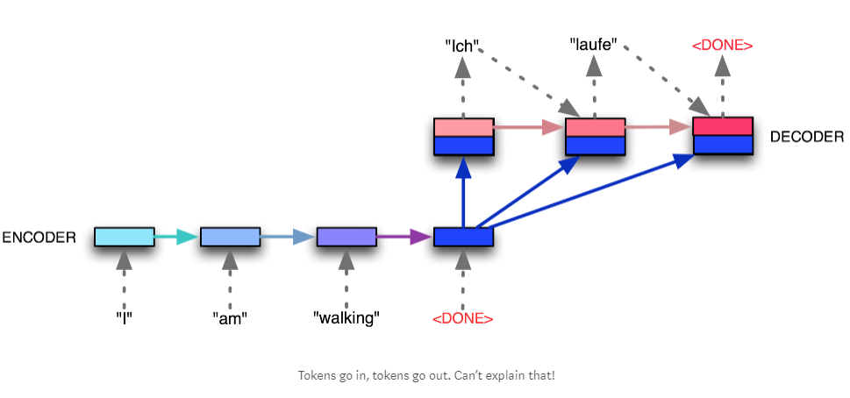
Seq2Seq Image-to-Image Models
Seq2Seq models are used in applications where the input is one format and the output is in other format.
Thus, we can use to for language translation, image captioning, text summarization, etc.
For our application we give the grayscale input to the encoder and the decoder is used for colorization of the images.

Slide 4
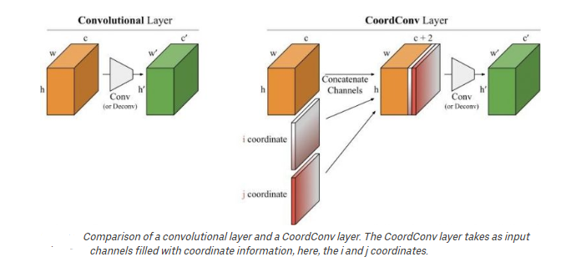
Co-ordinate Convolutional Layers

Slide 5
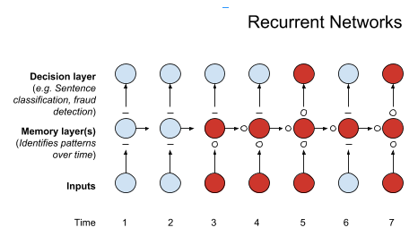
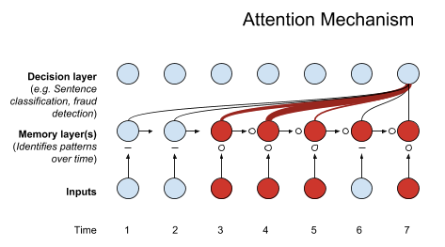
Attention Mechanism

Slide 6
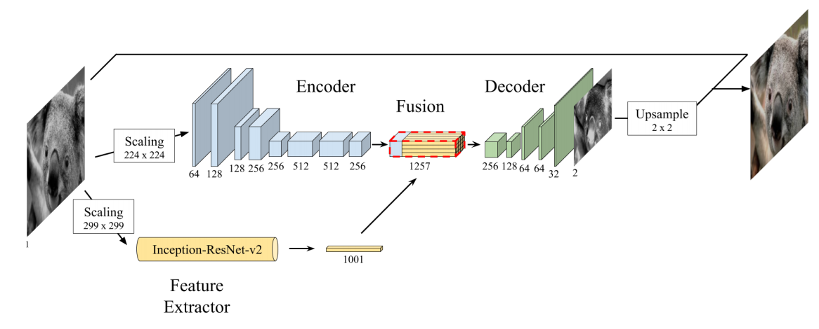

The architecture of the model

Slide 7

Dataset and Evaluation Metrics
Dataset used:
ImageNet for pre-training of the ResNet V2 Inception
FloydHub Public dataset – Containing of 9500 images taken by professional photographers and 500 on the validation set.
Computational Visual Cognition Laboratory MIT, Urban and Natural Scene Categories.
Evaluation Metric:
C(X, θ) = MSE(tanh(X)-tanh($\overline{X}$))
Where, X is the target vector of the image
$\overline{X}$ is the predicted vector of the image

Slide 8
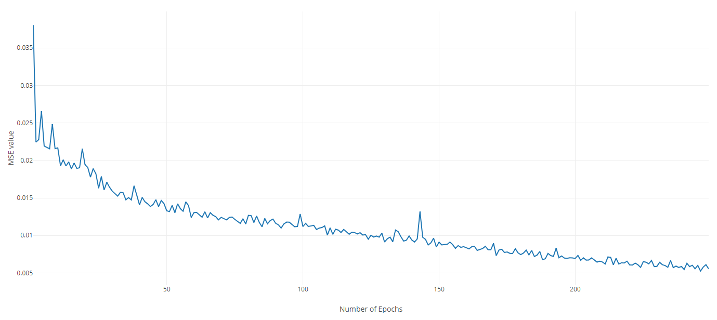
Results and comparison to baseline model

Slide 9
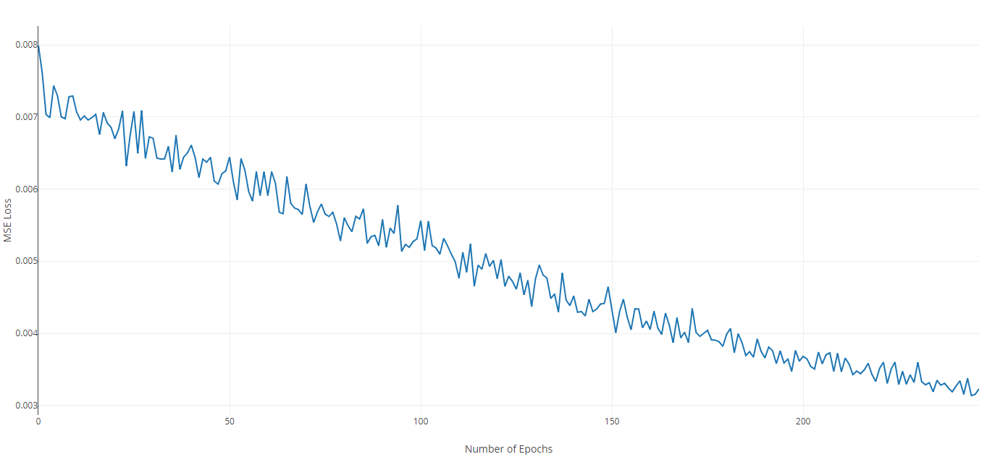

Slide 10
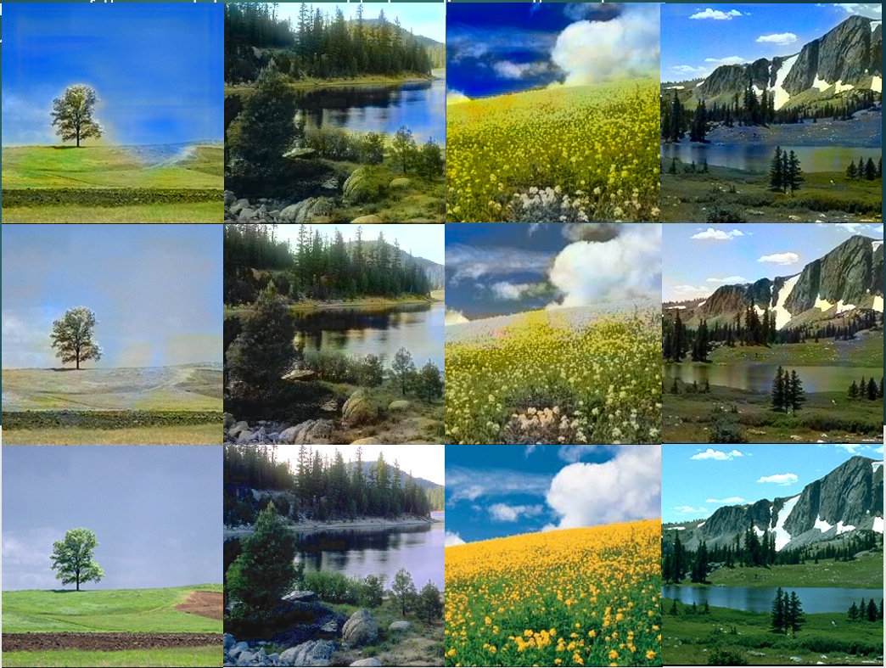
Results and comparison to baseline models
Resulting image of the model, compared to baseline results and ground truth:

Slide 11
Future work
Test the model on a bigger dataset with more variance between images. Test how well the model can generalize.
Try to compare this model with a State-of-art Generative Adversarial Network Model.
Use Fast R-CNN model for the encoder and decoder or as a secondary model instead of the Inception V3 model.

Slide 12
Thank You

